Slide 1




Agentica - GeoGuide Hackathon
Project by Team FLOW : GeoSpace
Team Member
Role
Affiliation
Stalin Velayudham
Team Leader
IIITS 2025
Tholkappian
Member
IIITS 2025
Sudhan Y
Member
IIITS 2025
Siddarth Vijayan B
Member
IIITS 2025
Moulidharan R
Member
IIITS 2025
Agentica sponsored by Station-S

Slide 2
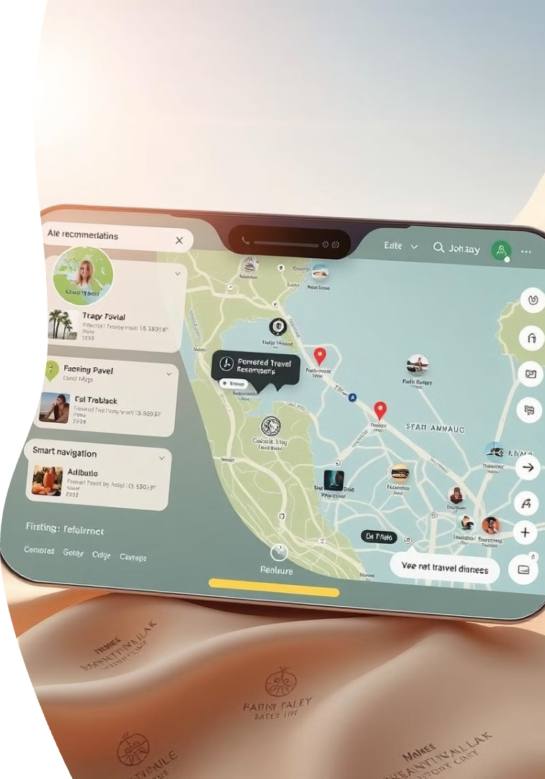

The Travel Planning Challenge: Complexity in a Connected World
Modern travel is complex, with countless options and fast-changing information.
1
Travellers need personalized recommendations, real-time insights, and seamless navigation.
2
How GeoGuide AI Works: Machine Learning Meets Travel Technology
GeoGuide utilizes powerful Machine Learning algorithms to analyze vast amounts of data.
These algorithms understand traveler preferences and predict optimal travel plans.
1
2
3
The AI dynamically learns and adapts based on user interactions and feedback.
Key Features
1
Personalized Travel
2
LiveUpdates
3
Smart Navigation
Agentica sponsored by Station-S

Slide 3



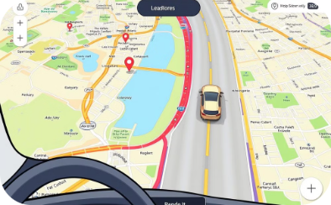
TECHNICAL APPROACH
Machine Learning (ML) And Cluster
Natural Language Processing (NLP)
Sentiment Analysis
GPS Tracking
GeoGuide AI uses clustering
Method to group travelers by preferences.
Enables natural language interaction.
GeoGuide AI BOT analyzes user sentiment in chats.
Provides real-time navigation.
Techniques Used: K-Means,
DBSCAN,
Hierarchical Clustering
Models Used: OpenAI GPT, BERT, Transformer-based architectures
Implementation: Deep Learning-based sentiment classification
APIs Used: Google Maps API, OpenWeather API
Agentica sponsored by Station-S

Slide 4

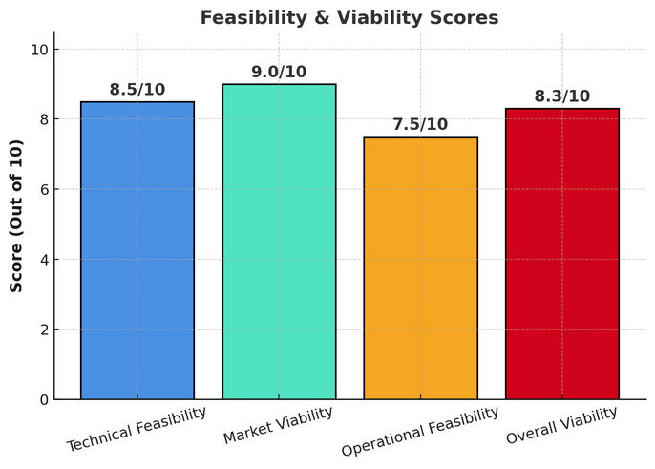
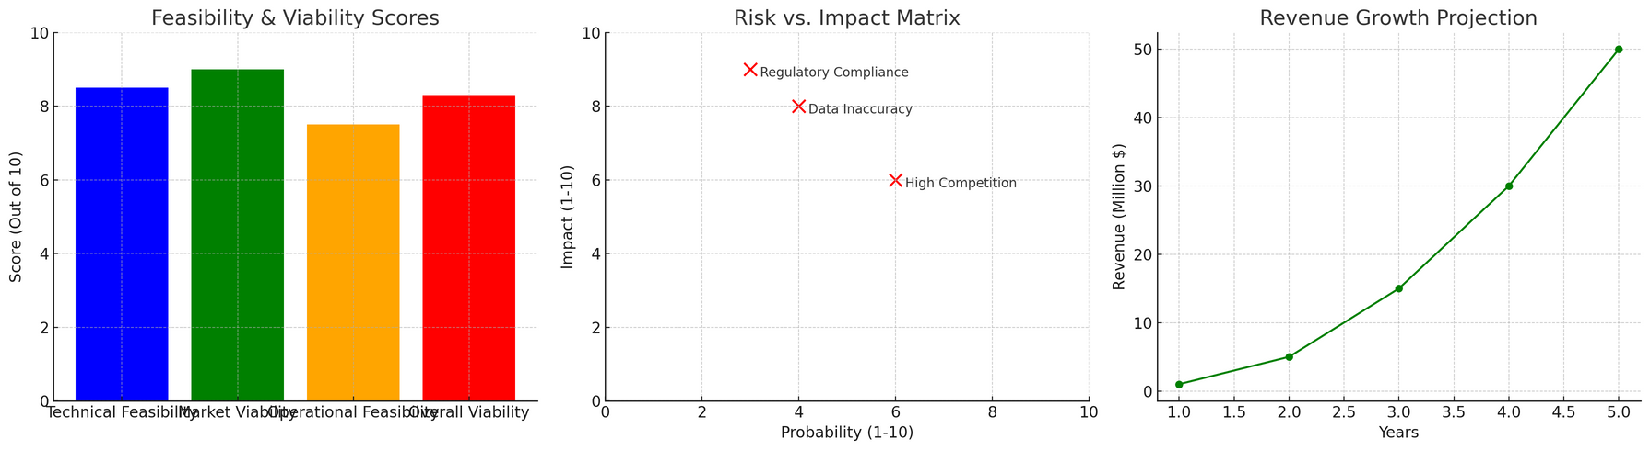
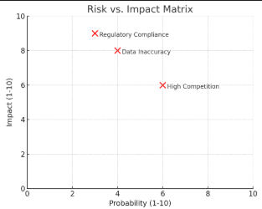
Technical and Market Feasibility Analysis
Market Analysis
Financial Projections
Examine industry trends and target user demographics
Model potential revenue streams and operational costs
1
2
3
Technical and Risk Assessment
Evaluate cloud architecture and data integration requirements
And analysis with impact and probability
Agentica sponsored by Station-S

Slide 5
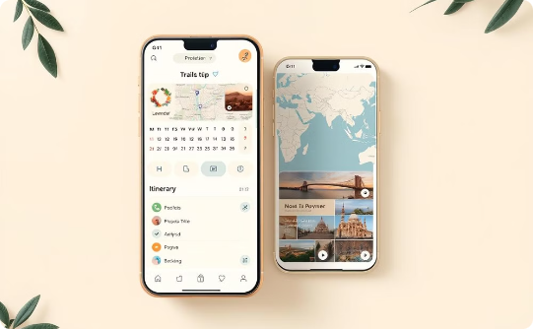
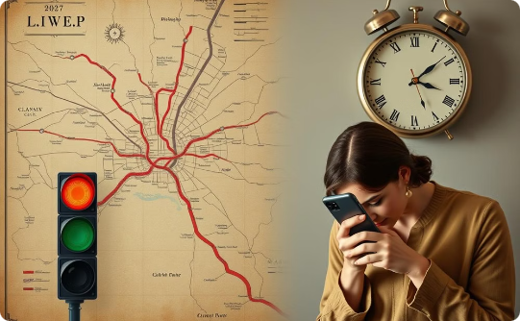

Impact & Benefits of GeoGuide AI BOT
Enhances Travel Planning
Smart Decision-Making
Optimizes Travel Processes
Automates itinerary creation, reducing stress and saving time.
Provides live updates on traffic conditions, ensuring smoother travel.
Offers personalized travel recommendations based on user preferences.
Agentica sponsored by Station-S

Slide 6
Research Areas & Technologies Used
Interactive AI & Conversational Systems (NLP & Chatbots)
Clustering & User Classification
Sentiment Analysis for Travel Recommendations
Real-Time Navigation & Smart Travel Assistance
Research: Zhang, Y., & Wang, J. (2021). "Artificial Intelligence in Smart Tourism." (Tourism Management Perspectives).
Research: Google AI Blog - Enhancing Navigation Systems with AI and ML.
APIs Used: Google Maps, OpenWeather, TripAdvisor, Yelp
Research: Ricci, F., Rokach, L., & Shapira, B. (2015). "Recommender Systems Handbook" (Springer).
How It’s Used: AI processes live location, weather, traffic, and user reviews to generate the best travel plan.
How It’s Used: AI analyzes user reviews & chat sentiment to improve recommendation accuracy.
How It’s Used: ML-based clustering categorizes travelers into groups (Adventurers, Foodies, etc.) for personalized suggestions.
How It’s Used: NLP enables human-like conversations, voice interaction, and smart trip recommendations.
APIs & External Data Sources Used
Google Maps API
OpenAI GPT API
OpenWeather API
Help & TriApdvisor API
For GPS-based navigation & real-time routing
For AI-powered conversational chatbot
For weather-aware travel suggestions
For review-based sentiment analysis & recommendations
Agentica sponsored by Station-S

